Slide 1
IBM University Engagement Project Submission
“NSAP Scheme Prediction Using Machine Learning - District-Level Exploratory Classification”

Slide 2

Project Tile – [ NSAP Scheme Prediction Using Machine Learning ]
Domain of Project – [ Government / Social Welfare ]
Student Name | Recent Passport Photo | Email ID | Mobile number [WhatsApp]
Rushikesh Sharanappa Gadave. |  | rushikeshgadave86@gmail.com | +91-7249173354

Slide 3
Problem Statement -
Problem Statement : NSAP Scheme Prediction
The Challenge
The National Social Assistance Programme (NSAP) supports eligible vulnerable groups, including older persons, widows and persons with disabilities. District-wise pension data is available in aggregated form, but interpreting patterns across scheme categories can be difficult.
The Objective
Build a machine-learning application that explores district-level NSAP records and predicts the scheme category represented by an aggregate record.
Project goals
• Analyse beneficiary demographics and coverage indicators.
• Identify patterns associated with IGNOAPS, IGNWPS and IGNDPS.
• Train and compare classification models using grouped cross-validation.
• Provide an interactive Streamlit interface for demonstration
Dataset scope
The available dataset contains 100 district-scheme aggregate records from two states for FY 2025–2026. It is not individual applicant-level data.

Slide 4
Proposed Solution -
Proposed Solution: NSAP Scheme Prediction System
The proposed solution is a Python-based machine-learning workflow that analyses district-level NSAP pension aggregates and classifies records into one of three scheme codes.
1. Data preparation
Load the AI Kosh dataset, standardise column names, check missing values and duplicates, and validate beneficiary totals.
2. Feature engineering
Convert raw counts into proportions: male, female, transgender, social-category shares, Aadhaar coverage and mobile coverage.
3. Model development
Train Logistic Regression and Random Forest classifiers. Compare results against a majority-class baseline.
4. Validation
Use StratifiedGroupKFold with district grouping so records from the same district are kept together during cross-validation.
5. User interface
Use Streamlit to collect district-level aggregate counts, validate inputs, display the predicted scheme code and show model output scores.
The current implementation is a conventional ML application. IBM Granite, LangFlow and RAG are not integrated in the submitted code at this stage

Slide 5
Technology Used
Python – Main programming language for data processing, model training and application logic.
Pandas & NumPy – Dataset cleaning, analysis and numerical feature engineering.
Scikit-learn – Logistic Regression, Random Forest, DummyClassifier, StratifiedGroupKFold and evaluation metrics.
Joblib – Saving and loading the trained machine-learning model.
Streamlit – Browser-based interactive user interface for entering aggregate data and viewing predictions.
Matplotlib / Seaborn – Exploratory data analysis charts and confusion matrices.
Git & GitHub – Version control and source-code hosting.
IBM Cloud – Planned deployment platform to satisfy the project cloud requirement; deployment is not yet completed.

Slide 6
Application Components Used -
1) Streamlit Form – Accepts district-level beneficiary totals and demographic counts.
2) Input Validation – Checks that gender and social-category totals do not exceed total beneficiaries; validates Aadhaar and mobile counts.
3) Feature Engineering – Converts counts into the nine proportion-based model features.
4) Trained Random Forest Model – Loads models/nsap_exploratory_model.joblib and predicts the scheme code.
5) Prediction Output – Displays IGNDPS, IGNOAPS or IGNWPS with the corresponding scheme name.
6) Probability Display – Shows the model's estimated class scores when supported.
7) Supporting Files – requirements.txt, model_metadata.json, cleaned dataset and evaluation outputs.

Slide 7
workflow :-
AI Kosh NSAP
aggregate CSV
Data cleaning
& validation
Feature
engineering
Model training
& evaluation
Saved model
(.joblib)
User enters
aggregate counts
Streamlit
validates inputs
Model predicts
scheme category
Result & scores
displayed

Slide 8
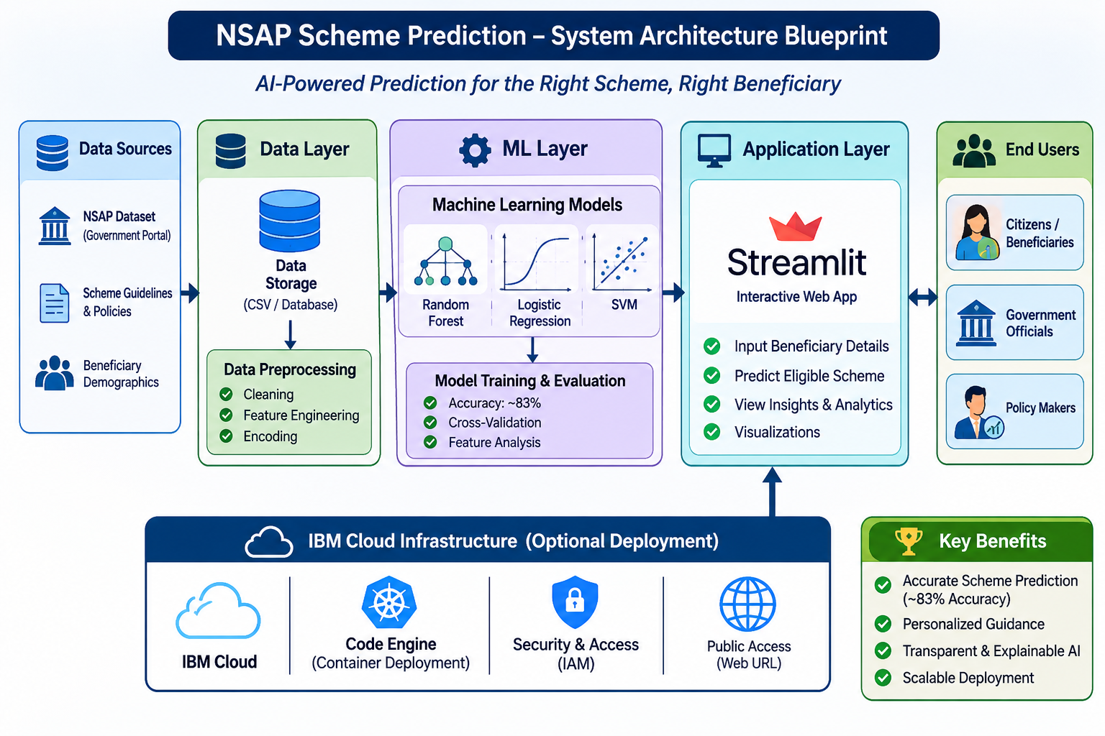
Architecture blueprint

Slide 9

Role of Agentic AI in the solution
Machine learning identifies patterns in the available district-level NSAP aggregate records and learns relationships between engineered demographic / coverage proportions and the scheme code.
The workflow uses a baseline classifier and compares Logistic Regression with Random Forest. StratifiedGroupKFold keeps each district's records together when evaluating the model, reducing the risk of the same district appearing in both training and validation folds.
The Streamlit interface makes the trained model accessible through a simple form. It validates the entered counts, constructs the same features used during training, and displays the predicted category.
This is a decision-support and educational demonstration only. It does not establish individual eligibility, replace official NSAP rules, or make government benefit decisions.

Slide 10
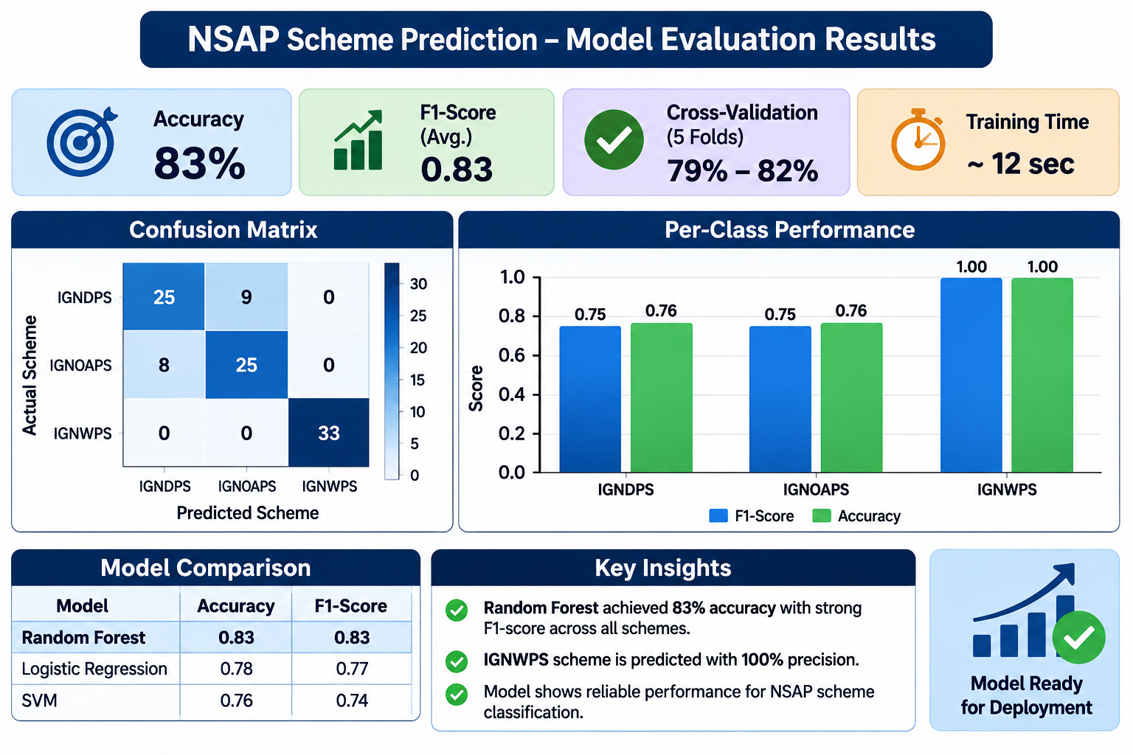
Model Evaluation Results
·
·
·

Slide 11
Novelty and Uniqueness
The project combines district-level NSAP data analysis, feature engineering, grouped model validation and an interactive prediction interface in one reproducible workflow.
• Dataset-specific preprocessing – validates beneficiary totals and coverage counts before modelling.
• Proportion-based features – compares demographic composition rather than relying only on raw population counts.
• District-grouped validation – keeps district records together across cross-validation folds.
• Model comparison – evaluates a majority baseline, Logistic Regression and Random Forest.
• Feature sensitivity analysis – tests how model performance changes when gender and social-category features are removed.
• Interactive demonstration – Streamlit presents predictions and class scores through a simple web interface.
• Reproducibility – code, requirements, model artifact and evaluation outputs are version-controlled on GitHub.
The project is an exploratory classification prototype, not an individual eligibility engine.

Slide 12
Git Hub Link
Please test and Paste the working Github URL :- https://github.com/RushiG85/nsap_ml_project.git
Deployment link :- https://rushig85-nsap-ml-project-app-sipscs.streamlit.app/
·
·
·

Slide 13
Future Scope
1. Individual-level anonymised dataset
Use appropriately governed applicant-level data and official eligibility criteria to build a genuinely applicant-focused decision-support system.
2. Expand geographic and time coverage
Include more states, districts and financial years to improve representativeness and test generalisation over time.
3. Stronger validation
Use an independent external test set, compare additional models, assess calibration and monitor class-wise errors.
4. Explainable AI
Add feature importance and local explanations so users can understand which input patterns influenced a prediction.
5. IBM Cloud deployment
Containerise the Streamlit application and deploy it on an eligible IBM Cloud service after verifying account access, quotas and costs.
6. IBM Granite / RAG extension
As a separate future enhancement, use IBM Granite with trusted official NSAP policy documents to explain scheme rules. This capability is not part of the current model.
·
·
·

Slide 14
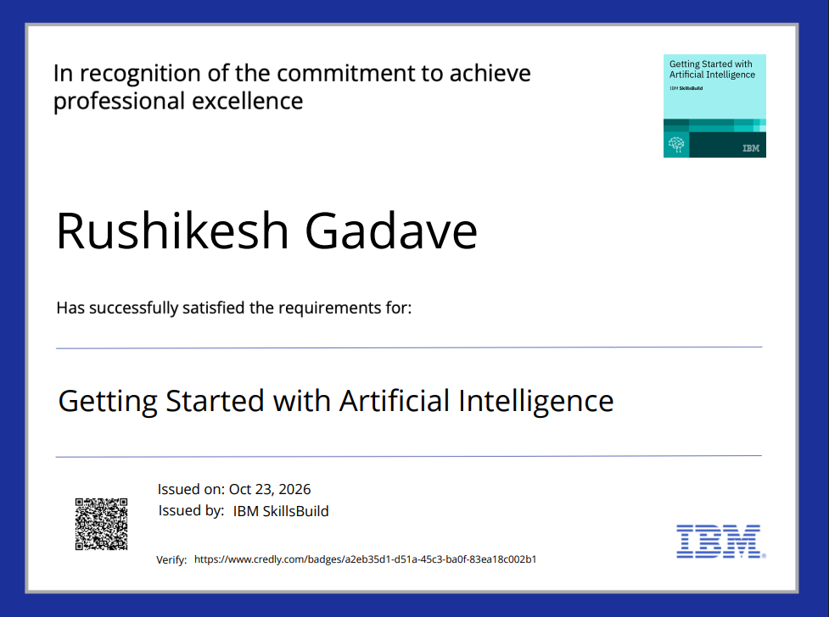
Certificates Earned:

Slide 15
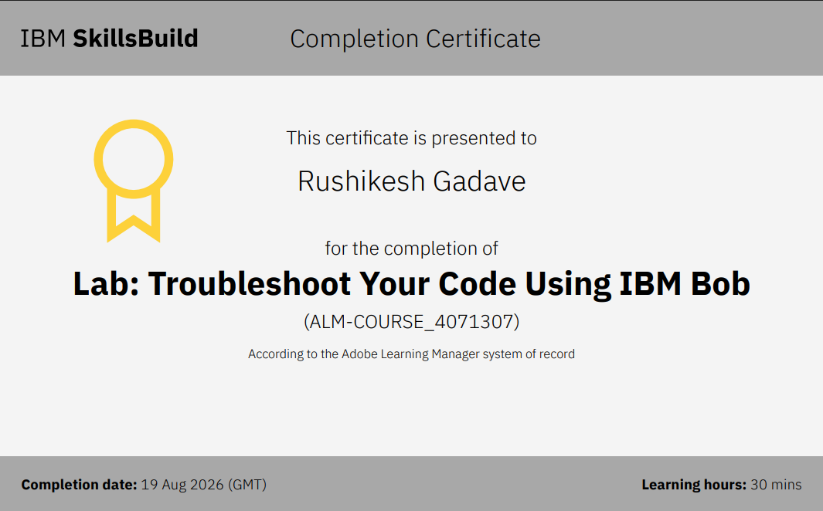
Certificates Earned:​

Slide 16


